Slide 1


Can We Know?

Slide 2
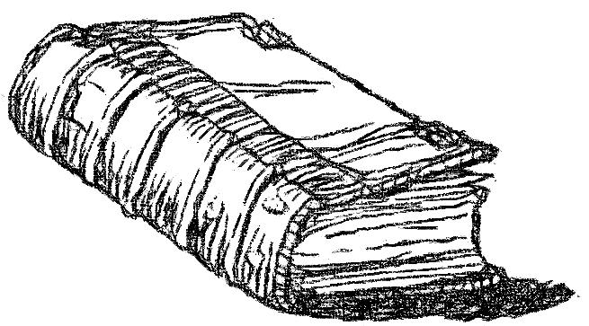
So Moses said to him, "As soon as I have gone out of the city, I will spread out my hands to the LORD; the thunder will cease, and there will be no more hail, that you may know that the earth is the LORD’S.
Exodus 9:29

Slide 3
Beware lest anyone cheat you through philosophy and empty deceit, according to the tradition of men, according to the basic principles of the world, and not according to Christ.
Colossians 2:8

Slide 4
EVOLUTION or
CREATION?
Why do some believe in evolution?
Does it make any difference?
Can we really know which is true?
All verses are from the NKJV unless noted.

Slide 5
Much Misinformation
Evolution Exalted, “So evolution is ‘just a theory’ the same way that the theory of plate tectonics and the germ theory of disease are just theories. And gravity.” (http://www.strangescience.net/evolution.htm)
  NOT SO!
  We “observe” the repeatable effects of “germs,” “tectonics,” and “gravity.”
  We do not “observe” fish evolving into reptiles, reptiles into birds, etc., etc.!
  If evolution is “too slow” to observe, then evolutionists believe in the unseen!

Slide 6
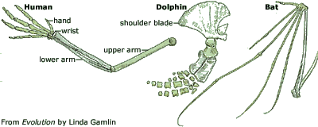
Same Data Interpreted Differently
Evolutionist:
Creationist:
“Great evidence for a common descent!”
“Great evidence of a common designer!”

Slide 7
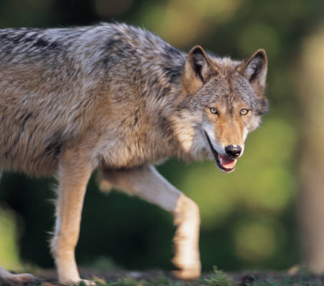
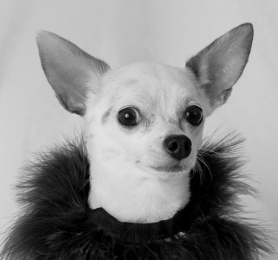
Same Data Interpreted Differently
The Evolutionist
“Humans have bred dogs, birds, cows and corn to their desires for hundreds, if not thousands, of years. If farmers and breeders could bring about such big changes in the short time span of recorded history, what could nature do?” (www.strangescience.net/evolution.htm)

Slide 8
Same Data Interpreted Differently
The Creationist
The same kind of animal
The variation of genetic information that exists within the kind is extensive
The changes are a result of a loss of genetic information, not an increase
“backwards evolution!”

Slide 9
Same Data Interpreted Differently
The Creationist
“We have observed the change in dogs over time, but that doesn’t mean that evolution has occurred. You can breed wolves to get to chihuahuas, but you can’t breed chihuahuas to get wolves”
(www.answersingenesis.org/articles/ee/natural-selection-vs-evolution)

Slide 10
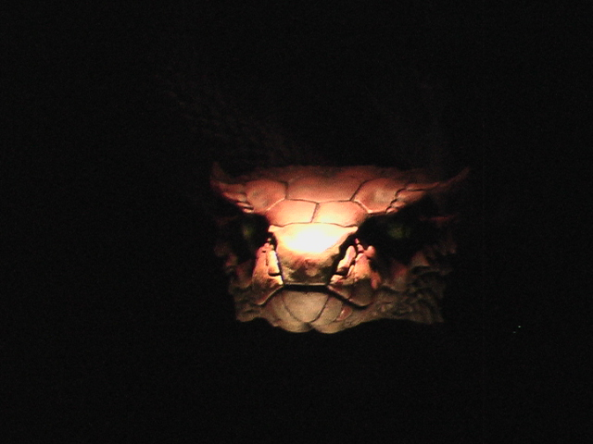
Evolution –Atheism
Atheism
Evolution
Humanism
Naturalism
ATHEISM –the belief that any supreme intelligence (GOD), does not exist

Slide 11
Biblical Assertions
Psalm 95:6
  Oh come, let us worship and bow down; Let us kneel before the LORD our Maker.
Psalm 100:3
  “Know that the LORD, He is God; It is He who has made us, and not we ourselves; We are His people and the sheep of His pasture.”

Slide 12
Biblical Assertions
Psalm 119:73
  YOD. Your hands have made me and fashioned me; Give me understanding, that I may learn Your commandments.
Psalm 139:13, 14
  For You formed my inward parts; You covered me in my mother’s womb. I will praise You, for I am fearfully and wonderfully made…And that my soul knows very well.

Slide 13
Biblical Assertions
Psalm 139:16
  Your eyes saw my substance, being yet unformed. …
Job 10:8
  Your hands have made me and fashioned me, An intricate unity; Yet You would destroy me.

Slide 14
Biblical Assertions
Acts 17:28, 29
  “for in Him we live and move and have our being, as also some of your own poets have said, ‘For we are also His offspring.’
  Therefore, since we are the offspring of God, we ought not to think that the Divine Nature is like gold or silver or stone, something shaped by art and man’s devising.”

Slide 15
It Makes A Difference:
Does it make a difference if one believes in evolution or creation?
On how we view ourselves

Slide 16

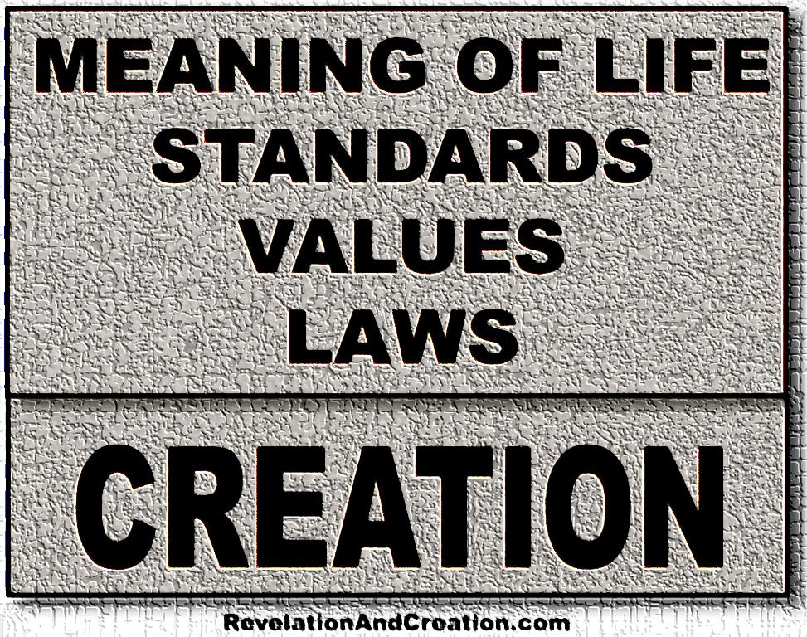
What’s In Your Ancestry?
ADAM & Eve
PHOTO: FROM INSIDE THE CREATION MUSEUM IN PETERSBURG, KENTUCKY

Slide 17

What’s In Your Ancestry?
Ameba & Ape

Slide 18
It Makes A Difference:
Does it make a difference if one believes in evolution or creation?
On how we view ourselves and each other
On how we view and treat others
“Where there is no revelation, the people cast off restraint; But happy is he who keeps the law.”
Proverbs 29:18

Slide 19
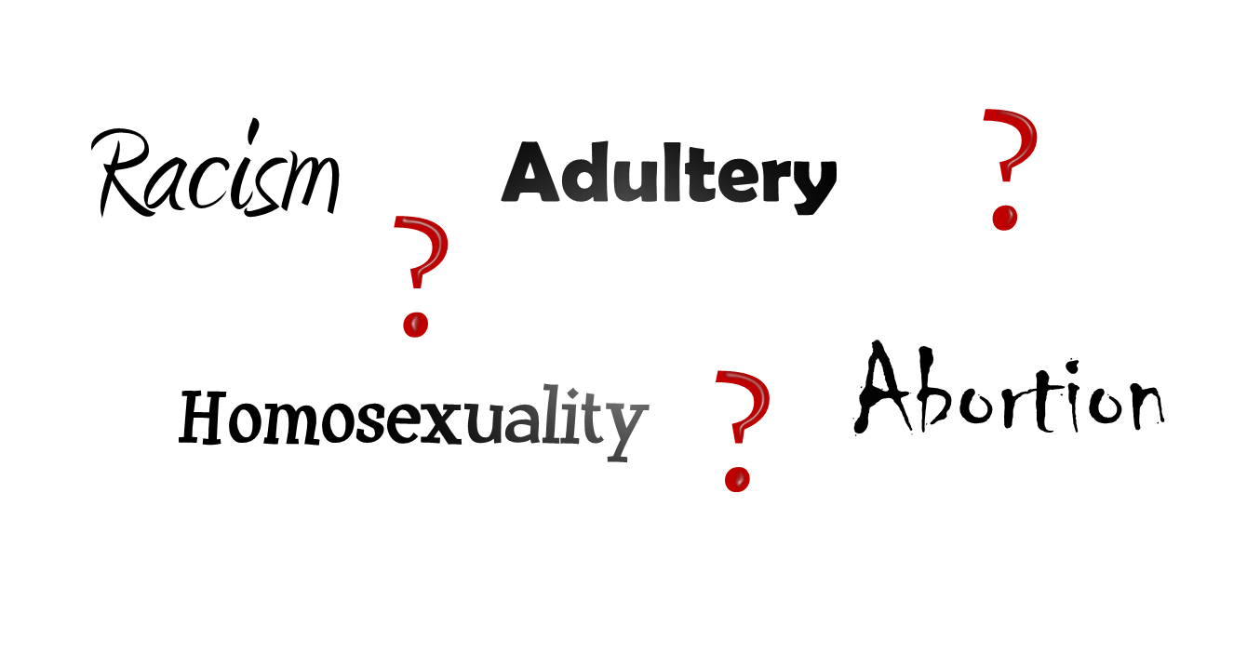
“So God created man in His own image; in the image of God He created him; male and female He created them.”
Genesis 1:27

Slide 20

One Race
Adam’s Race

Slide 21
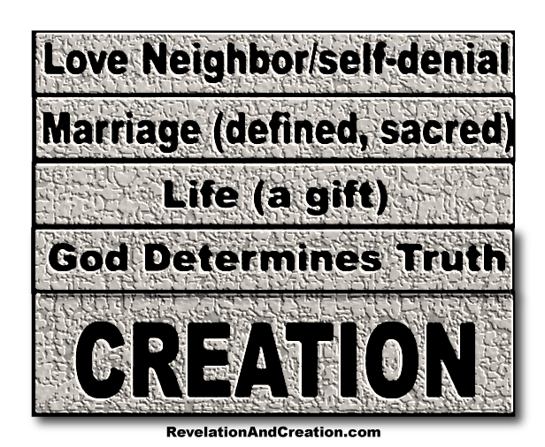
What’s In Your Ancestry?
ADAM & Eve
PHOTO: FROM INSIDE THE CREATION MUSEUM IN PETERSBURG, KENTUCKY

Slide 22
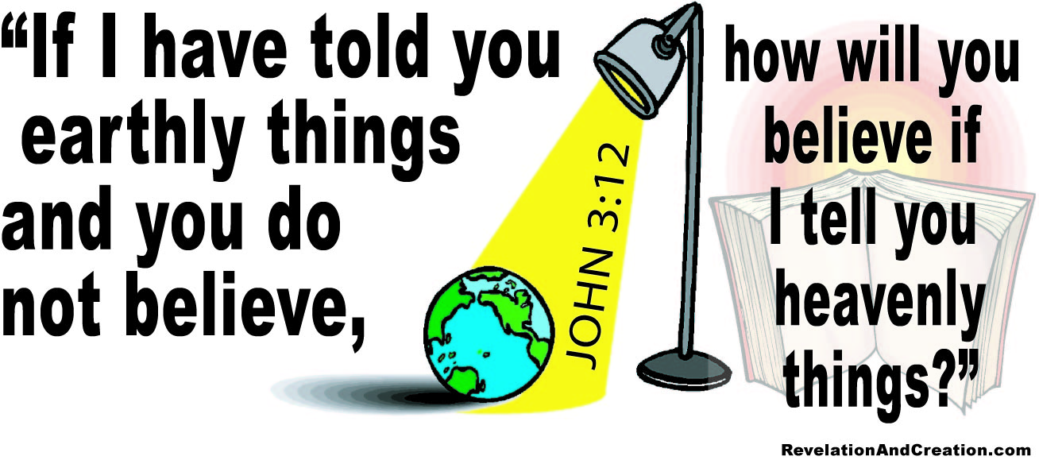
It Makes A Difference:
Does it make a difference if one believes in evolution or creation?
On how we view ourselves and each other
On how we view and treat others
On how we view the authority of the Bible

Slide 23
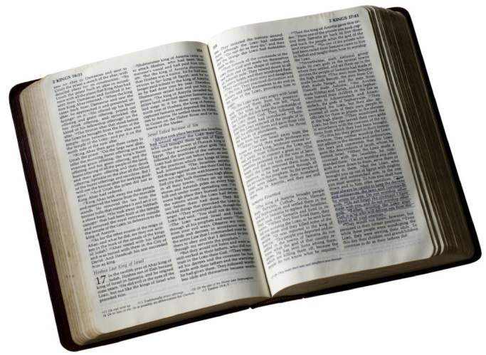
Authority of Bible Rests Upon Real History
CREATION
Genesis 1:1ff
Rev. 20:9ff
CORRUPTION
CATASTROPHE
CONFUSION
CONSUMMATION
(FUTURE)
CHURCH ←CROSS← CHRIST

Slide 24
Authority of Bible Rests Upon Real History
If This Is False
CREATION
What Follows Is False
Genesis 1:1ff
Rev. 20:9ff
CORRUPTION
CATASTROPHE
CONFUSION
CONSUMMATION
(FUTURE)
CHURCH ←CROSS← CHRIST

Slide 25
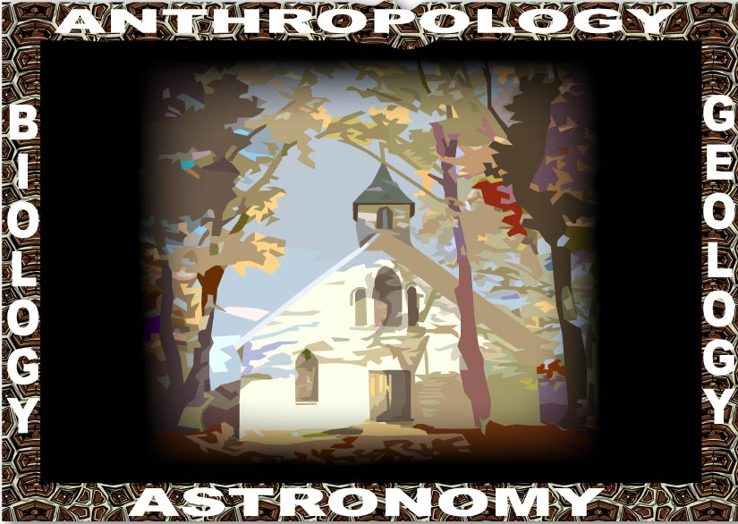
A Biblical Framework Exists
Day six, flood, tower of Babel
Day 3, 5, 6
Day 3,
Flood
Day 4

Slide 26
It Makes A Difference:
Does it make a difference if one believes in evolution or creation?
On how we view ourselves and each other
On how we view others
On how we view the authority of the Bible
On how we view death

Slide 27
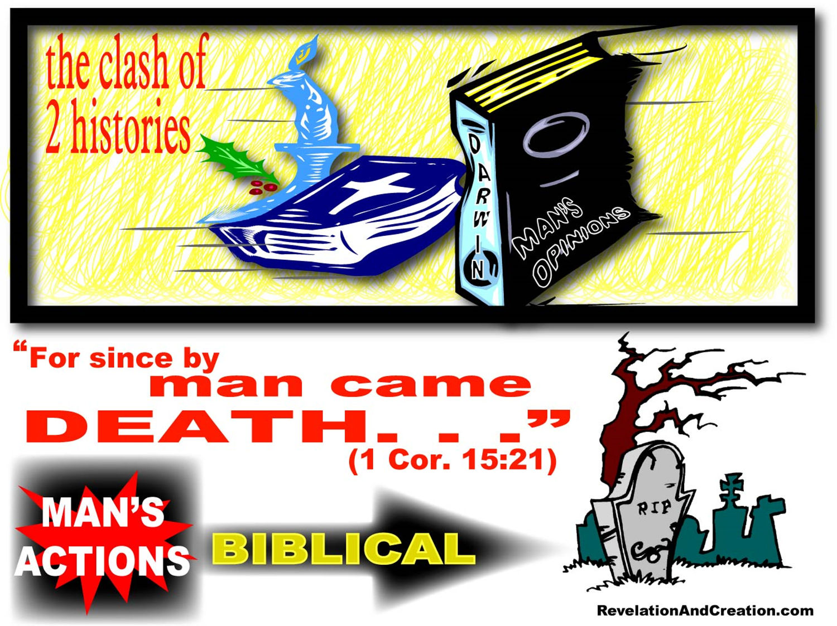

Slide 28


Slide 29
THE PLAN FOR
YOUR SALVATION
Hear the Word of God---Rom. 10:17
Believing In Your Heart---Heb. 11:6
Repenting Of Your Sins---Acts 2:38
Confess That Christ Is The Son of God--- Rom. 10:10; Acts 8:37
Be Baptized Into Christ---Gal. 3:26-29
Be Faithful Until Death---Rev. 2:10; I Cor. 15:58

